Slide 1
Secondary Storage Structure and Disk Scheduling Algorithm

Slide 2
Secondary Storage
Secondary storage devices are those devices whose memory is non volatile, meaning, the stored data will be intact even if the system is turned off. Here are a few things worth noting about secondary storage.
Secondary storage is also called auxiliary storage.
Secondary storage is less expensive when compared to primary memory like RAMs.
The speed of the secondary storage is also lesser than that of primary storage.
Hence, the data which is less frequently accessed is kept in the secondary storage.
A few examples are magnetic disks, magnetic tapes, removable thumb drives etc.

Slide 3
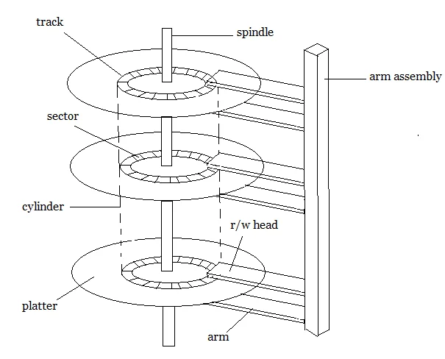
Magnetic Disk Structure
In modern computers, most of the secondary storage is in the form of magnetic disks. Hence, knowing the structure of a magnetic disk is necessary to understand how the data in the disk is accessed by the computer.
In computers the secondary storage typically is formed of stacked up magnetic disks on the top of one another.
One single unit of such disk is called platter.A single unit of secondary storage device like HDD may have 100-200 such platters stacked up on one another.
Each platter is divided into circular shaped tracks.

Slide 4
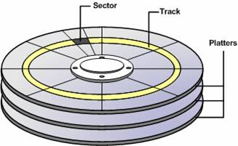
More about Magnetic Disk Structure
Note – The length of the tracks near the centre is less than the length of the tracks farther from the centre.
Each track is further divided into sectors. Each sector store 512 byte of data.
Spindle revolves the platters and is controlled by r/w unit of OS. Some advanced spindles have capability to only revolve a particular disk and keep others intact.
Arm Assembly is there which keeps a pointy r/w head on each disk to read of write on a particular disk.
A world cylinder may also be used at times to refer disk stack.
The speed of the disk is measured as two parts:
Transfer rate: This is the rate at which the data moves from disk to the computer.
Random access time: It is the sum of the seek time and rotational latency.

Slide 5
Disk Scheduling
Disk scheduling is done by operating systems to schedule I/O requests arriving for the disk. Disk scheduling is also known as I/O scheduling.
Disk scheduling is important because:
Multiple I/O requests may arrive by different processes and only one I/O request can be served at a time by the disk controller. Thus other I/O requests need to wait in the waiting queue and need to be scheduled.
Two or more request may be far from each other so can result in greater disk arm movement.
Hard drives are one of the slowest parts of the computer system and thus need to be accessed in an efficient manner.
There are many Disk Scheduling Algorithms but before discussing them let’s have a quick look at some of the important terms:

Slide 6
Disk Scheduling
The operating system is responsible for using hardware efficiently — for the disk drives, this means having a fast access time and disk bandwidth
Access time has three major components
Seek time is the time for the disk are to move the heads to the cylinder containing the desired sector
Seek time is the time taken by the arm to move to the required track.
Rotational latency is the additional time waiting for the disk to rotate the desired sector to the disk head
Rotational latency is defined as the time taken by the arm to reach the required sector in the track.
Transmission time is time to transfer information once it is under the head.
Transfer time is the time to transfer the data. It depends on the rotating speed of the disk and number of bytes to be transferred.
For most disks, the seek time dominates the other two times, so reducing the mean seek time can improve system performance substantially.

Slide 7
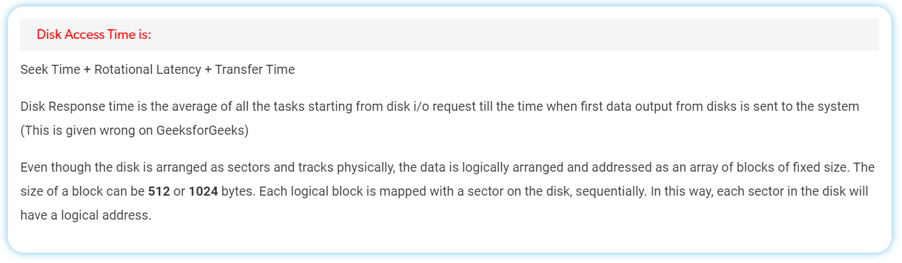
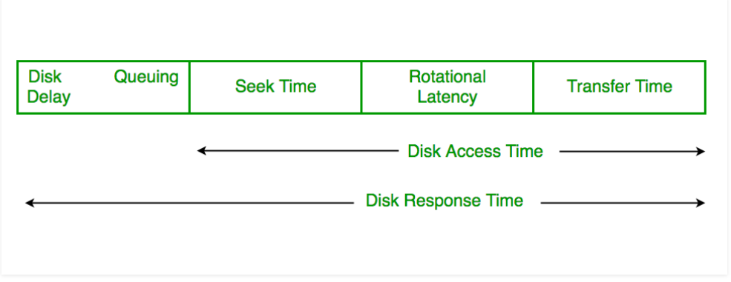

Slide 8
Disk Response Time: Response Time is the average of time spent by a request waiting to perform its I/O operation.
Average Response time is the response time of the all requests.
Variance Response Time is measure of how individual request are serviced with respect to average response time.
So the disk scheduling algorithm that gives minimum variance response time is better.

Slide 9
Disk Scheduling Algorithm

Slide 10
Types of disk arm scheduling algorithms:
FCSC (First come first serve)
SSTF (Shorted seek time first)
SCAN (Elevator)
C-SCAN
LOOK
C-LOOK

Slide 11
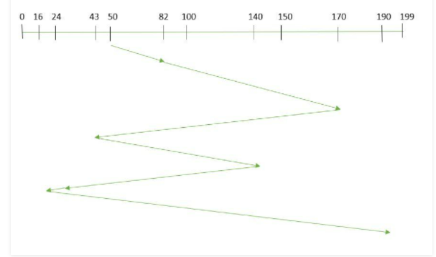
FCFS
FCFS is the simplest of all the Disk Scheduling Algorithms. In FCFS, the requests are addressed in the order they arrive in the disk queue.Let us understand this with the help of an example.
Example: Suppose the order of request is- (82,170,43,140,24,16,190) And current position of Read/Write head is : 50
Solution
Total seek time:
=(82-50)+(170-82)+(170-43)+(140-43)+(140-24)+(24-16)+(190-16)
=642
Total no of tracks movement/ Head movement:
=(170-50)+(170-43)+(140-43)+(140-16)+(190-16)
Advantages:
Every request gets a fair chance
No indefinite postponement
Disadvantages:
Does not try to optimize seek time
May not provide the best possible service

Slide 12
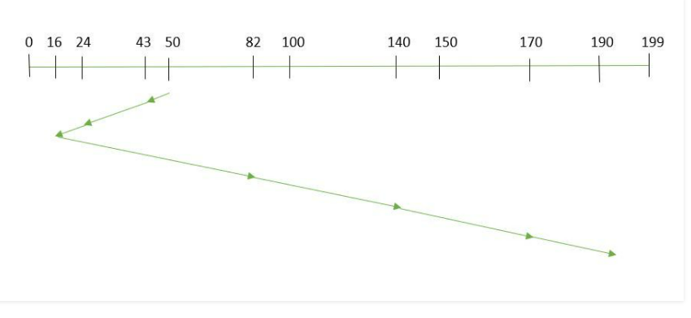
SSTF
In SSTF (Shortest Seek Time First), requests having shortest seek time are executed first. So, the seek time of every request is calculated in advance in the queue and then they are scheduled according to their calculated seek time. As a result, the request near the disk arm will get executed first. SSTF is certainly an improvement over FCFS as it decreases the average response time and increases the throughput of system.Let us understand this with the help of an example.
Example: Suppose the order of request is- (82,170,43,140,24,16,190) And current position of Read/Write head is : 50
Solution:
Total seek time:
=(50-43)+(43-24)+(24-16)+(82-16)+(140-82)+(170-40)+(190-170)
=208
Total no of tracks movement/ Head movement:
=(50-16)+(190-16)
=
Advantages:
Average Response Time decreases
Throughput increases
Disadvantages:
Overhead to calculate seek time in advance
Can cause Starvation for a request if it has higher seek time as compared to incoming requests
High variance of response time as SSTF favours only some requests

Slide 13
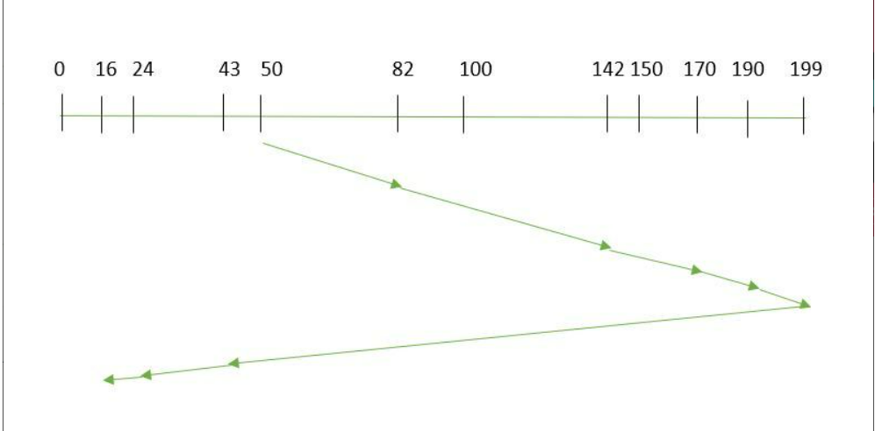
SCAN(Elevator)
In SCAN algorithm the disk arm moves into a particular direction and services the requests coming in its path and after reaching the end of disk, it reverses its direction and again services the request arriving in its path. So, this algorithm works as an elevator and hence also known as elevator algorithm. As a result, the requests at the midrange are serviced more and those arriving behind the disk arm will have to wait.
Example: Suppose the requests to be addressed are-82,170,43,140,24,16,190. And the Read/Write arm is at 50, and it is also given that the disk arm should move “towards the larger value”.
Solution:
the seek time is calculated as:
=(199-50)+(199-16)
=332
Total no of tracks movement/ Head movement:
=(199-50)+(199-16)
=
Advantages:
High throughput
Low variance of response time
Average response time
Disadvantages:
Long waiting time for requests for locations just visited by disk arm

Slide 14
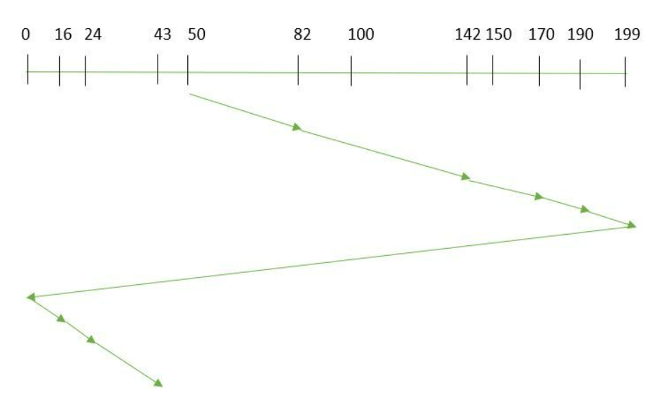
CSCAN
In SCAN algorithm, the disk arm again scans the path that has been scanned, after reversing its direction. So, it may be possible that too many requests are waiting at the other end or there may be zero or few requests pending at the scanned area.
These situations are avoided in CSCAN algorithm in which the disk arm instead of reversing its direction goes to the other end of the disk and starts servicing the requests from there. So, the disk arm moves in a circular fashion and this algorithm is also similar to SCAN algorithm and hence it is known as C-SCAN (Circular SCAN).
Example: Suppose the requests to be addressed are-82,170,43,140,24,16,190. And the Read/Write arm is at 50, and it is also given that the disk arm should move “towards the larger value”.
Solution:
Seek time is calculated as:
=(199-50)+(199-0)+(43-0)
=391
Total no of tracks movement/ Head movement:
=(199-50)+(199-0)+(43-0)
=
Advantages:
Provides more uniform wait time compared to SCAN

Slide 15
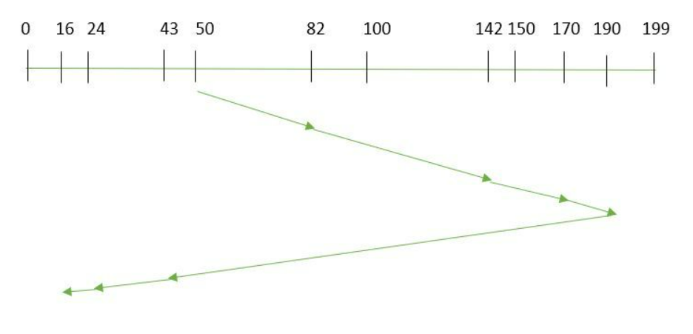
LOOK
It is similar to the SCAN disk scheduling algorithm except for the difference that the disk arm in spite of going to the end of the disk goes only to the last request to be serviced in front of the head and then reverses its direction from there only. Thus it prevents the extra delay which occurred due to unnecessary traversal to the end of the disk.
Example: Suppose the requests to be addressed are-82,170,43,140,24,16,190. And the Read/Write arm is at 50, and it is also given that the disk arm should move “towards the larger value”.
Solution
seek time is calculated as:
=(190-50)+(190-16)
=314
Total no of tracks movement/ Head movement:
=(190-50)+(190-16)
=314

Slide 16
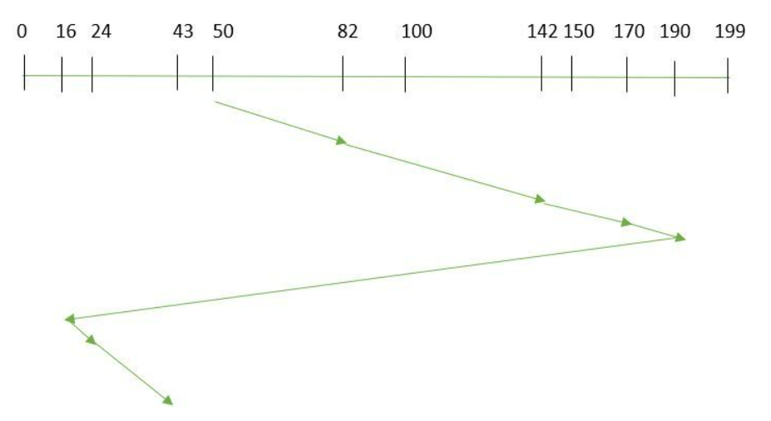
CLOOK
As LOOK is similar to SCAN algorithm, in similar way, CLOOK is similar to CSCAN disk scheduling algorithm. In CLOOK, the disk arm in spite of going to the end goes only to the last request to be serviced in front of the head and then from there goes to the other end’s last request. Thus, it also prevents the extra delay which occurred due to unnecessary traversal to the end of the disk.
Example:
Suppose the requests to be addressed are-82,170,43,140,24,16,190. And the Read/Write arm is at 50, and it is also given that the disk arm should move “towards the larger value”
Solution:
the seek time is calculated as:
=(190-50)+(190-16)+(43-16)
=341

Slide 17
Practice Question
Suppose a disk has 201 cylinders, numbered from 0 to 200. At some time the disk arm is at cylinder 100, and there is a queue of disk access requests for cylinders 30, 85, 90, 100, 105, 110, 135 and 145. If Shortest-Seek Time First (SSTF) is being used for scheduling the disk access, the request for cylinder 90 is serviced after servicing ____________ number of requests.
Consider an operating system capable of loading and executing a single sequential user process at a time. The disk head scheduling algorithm used is First Come First Served (FCFS). If FCFS is replaced by Shortest Seek Time First (SSTF), claimed by the vendor to give 50% better benchmark results, what is the expected improvement in the I/O performance of user programs?
Suppose the following disk request sequence (track numbers) for a disk with 100 tracks is given: 45, 20, 90, 10, 50, 60, 80, 25, 70. Assume that the initial position of the R/W head is on track 50. The additional distance that will be traversed by the R/W head when the Shortest Seek Time First (SSTF) algorithm is used compared to the SCAN (Elevator) algorithm (assuming that SCAN algorithm moves towards 100 when it starts execution) is _________ tracks

Slide 18
RAID

Slide 19
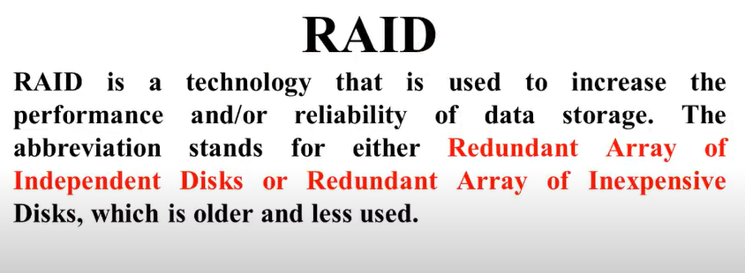
RAID – multiple disk drives provides reliability via
redundancy
All RAID have the property that the data are distributed over drives, to allow parallel operation.
RAID is arranged into six different levels

Slide 20
RAID (Cont.)
Several improvements in disk-use techniques involve the use of multiple disks working cooperatively
Disk striping uses a group of disks as one storage unit
RAID schemes improve performance and improve the reliability of the storage system by storing redundant data
Mirroring or shadowing (RAID 1) keeps duplicate of each disk
Striped mirrors (RAID 1+0) or mirrored stripes (RAID 0+1) provides high performance and high reliability
Block interleaved parity (RAID 4, 5, 6) uses much less
redundancy

Slide 21
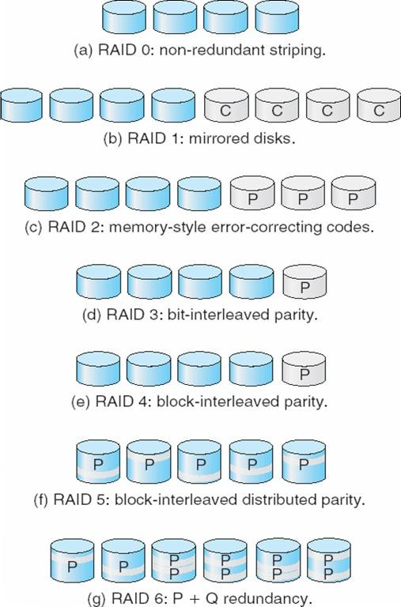
RAID Levels

Slide 22
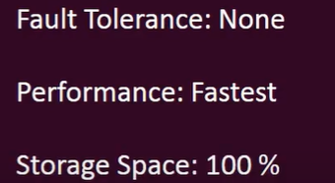
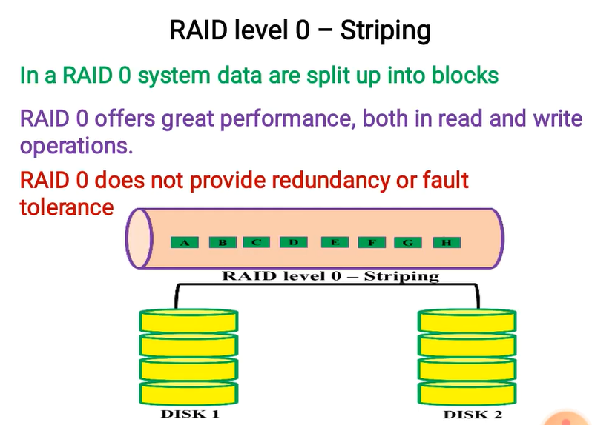
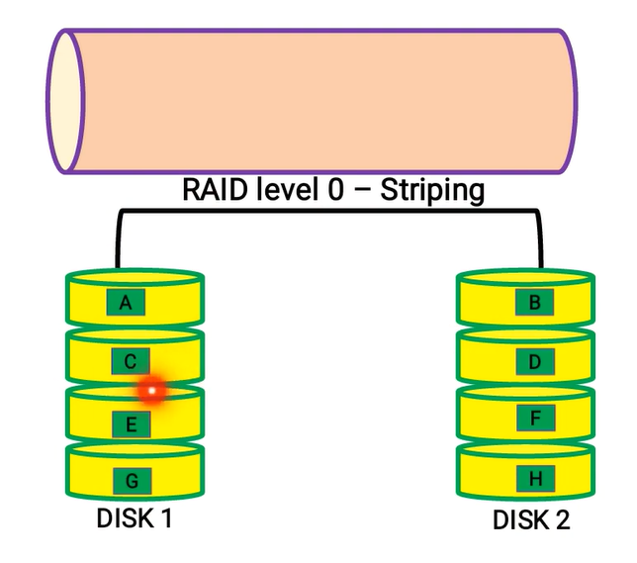

Slide 23
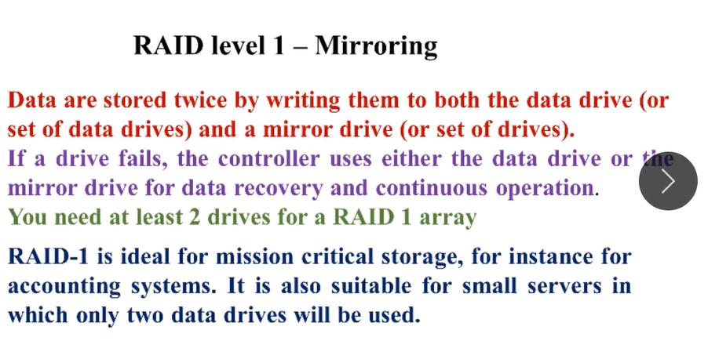

Slide 24
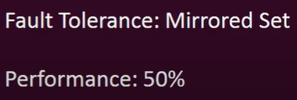
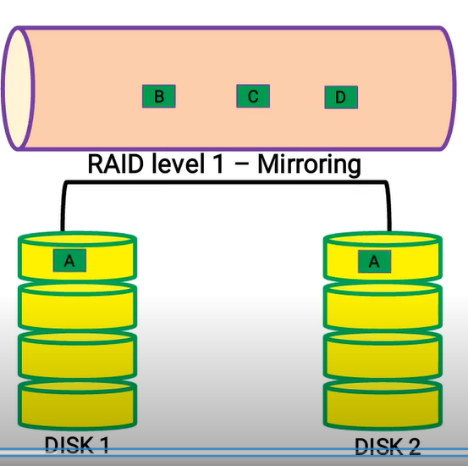
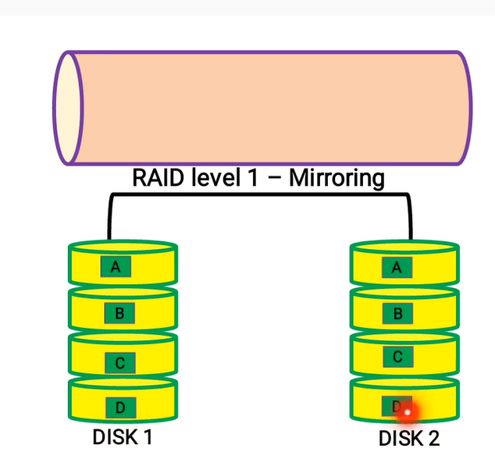

Slide 25
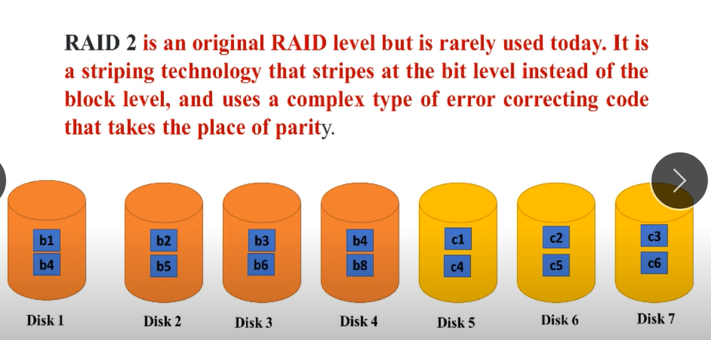
Note :Raid 2,3,4 is out dated not in use

Slide 26
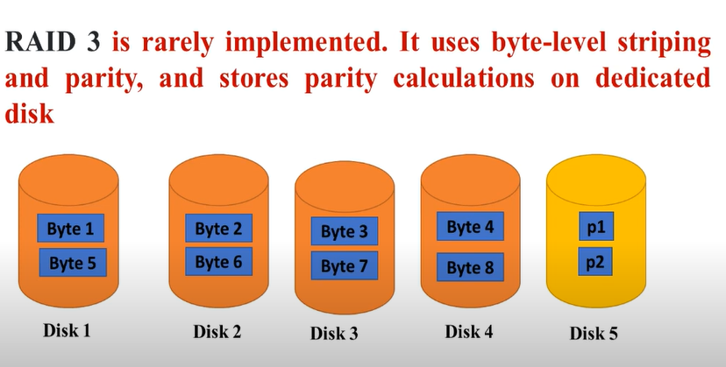
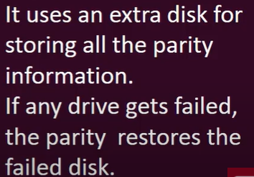

Slide 27
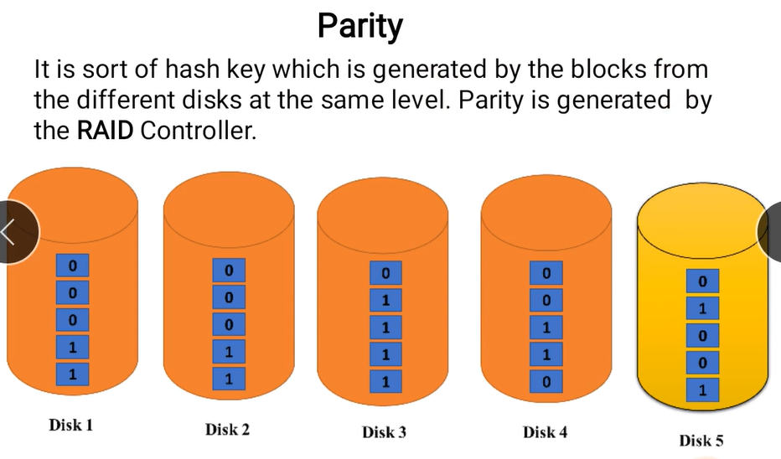

Slide 28
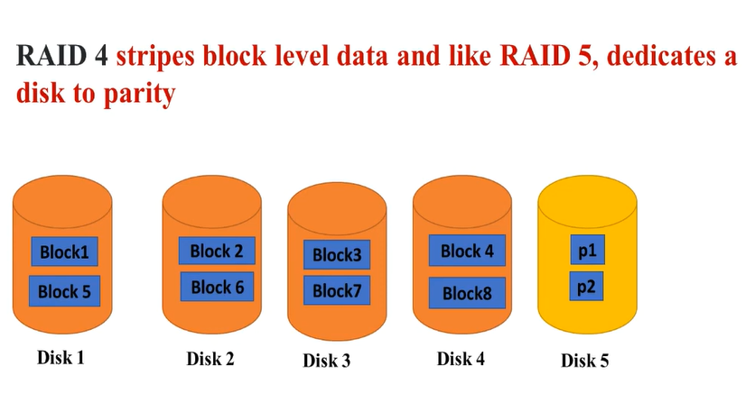
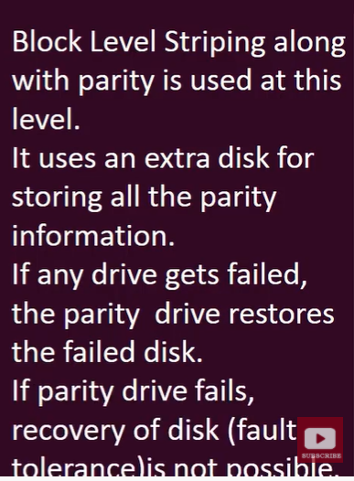

Slide 29
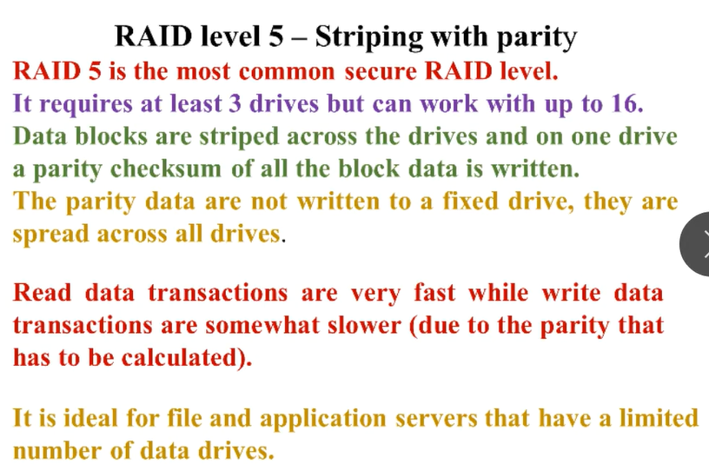
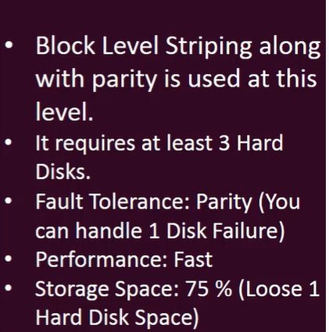

Slide 30
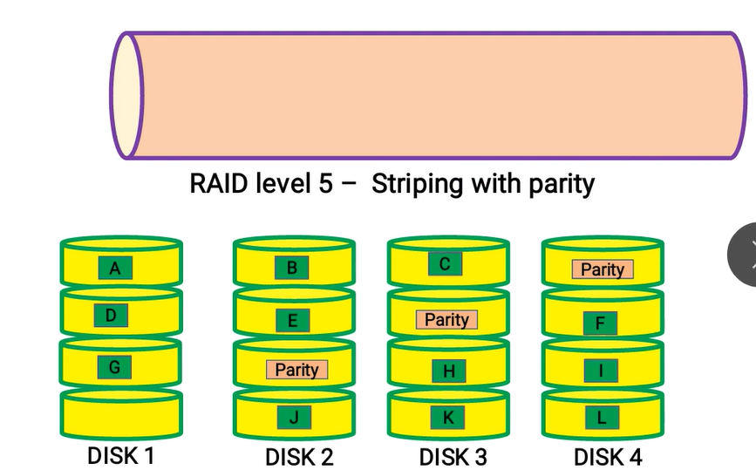

Slide 31
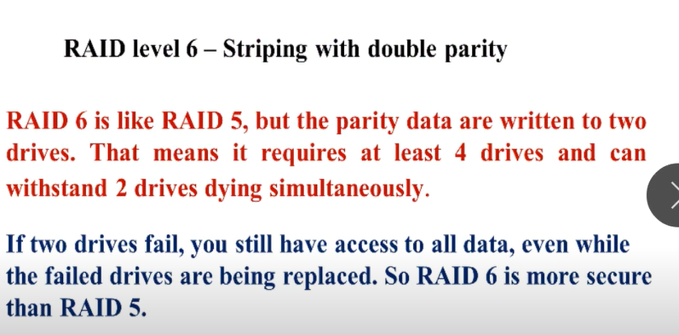

Slide 32
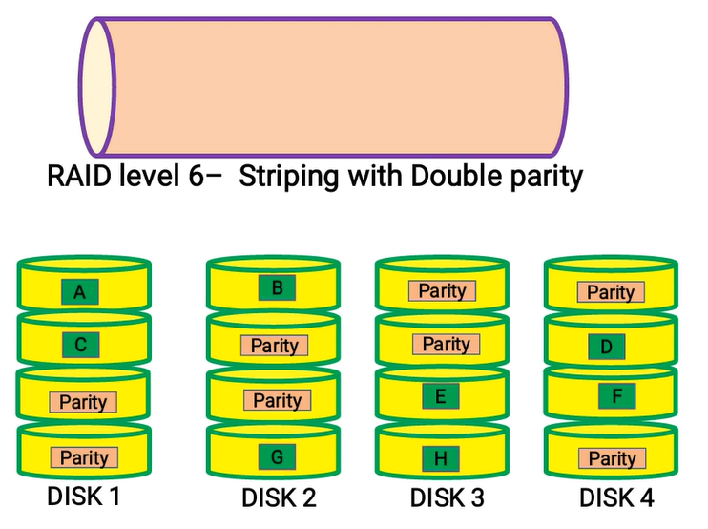

Slide 33
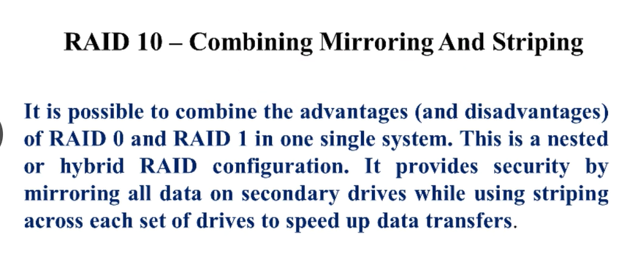

Slide 34
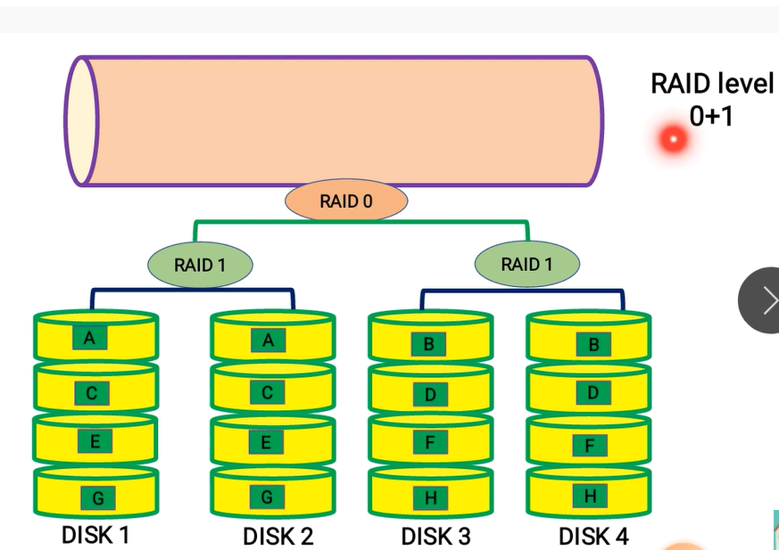

Slide 35
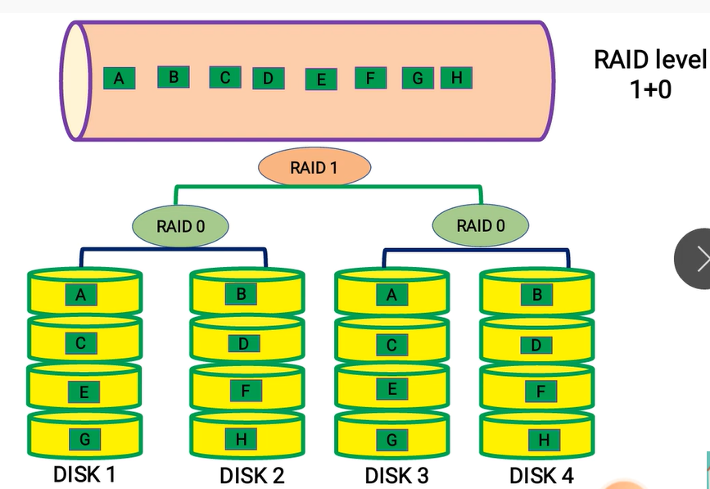

Slide 36
Conclusion
Raid 0 Data stripping
Raid 1 Data mirroring
Raid 2 Bit level Data stripping + Parity
Raid 3 Byte level Data stripping + Parity
Raid 4 Block level Data stripping + Parity
Raid 5 Block level Distributed Parity Bit
Raid 6 Block level Double Distributed Parity Bit
Raid 10 Hybrid

